Slide 1
BLE-Mesh App Install
Greg Carson, Mike Roberts, Victoria Bohanna Pea
BLE-Mesh 6HR Workshop 2019
Rev 01

Slide 2
Cypress’ BLE-Mesh software tools
Client Applications
Cypress offers several applications that can be used for provisioning, configuring, and communicating with mesh networks:
• Windows applications
Client Control Mesh
Mesh Client
• iOS application written
Cypress MeshApp ← Available in Play Store
• Android applications
MeshController by Cypress ← Requires Manual Install
Sylvania Smart Home by LedVance

Slide 3
Cypress’ BLE-Mesh software tools
Client Applications
Cypress’ tools create mesh networks, provision/configure and control devices
One or mode BLE-Mesh Nodes supporting a Proxy feature in a Mesh Network enable communication with legacy BLE equipment.
Cypress’ tools utilize standard BLE to communicate through the Proxy.
Source Code is provided for Cypress’ MeshController Android App
<Install_Folder>/ModusToolbox_1.1/libraries/bt_sdk-1.1/components/BT-SDK/common/apps/snip/mesh/peerapps

Slide 4
BLE Mesh App - Intro
iOS in Play Store - Android requires manual install
For iPhone users:
Download and install Cypress MeshApp from the Play Store
For Android users:
Copy the MeshLightingController.apk file into your Android device
<Install Folder>\ModusToolbox_1.1\libraries\bt_20819A1-1.0\components\BT-SDK\common\apps\snip\mesh\peerapps\Android\src\bin\MeshLightingController.apk
Note: The “bt_....” directory under “libraries” may change. It has been “bt_sdk-1.1” and “bt_20819A1-1.0”.

Slide 5
BLE Mesh App - Intro
Android – App install procedure
Connect the smartphone to a PC with a USB cable
In a FileExplorer window on the PC, Identify the phone’s filesystem.
Drop the MeshLightingController.apk into a directory on the phone’s filesystem.
Note: Place the .apk near the top of the file structure to avoid file path errors. Dropping into a Download folder or creating a CypressMesh folder first have both worked fine.
--- PC\SAMSUNG-SM-G950U\Phone\CypressMesh\MeshLightingController.apk
--- PC\SAMSUNG-SM-G935V\Phone\Download\MeshLightingController.apk
Install the Mesh App by finding it in your phone’s file system then selecting it.
Allow installation of 3rd party applications when the warning comes up

Slide 6
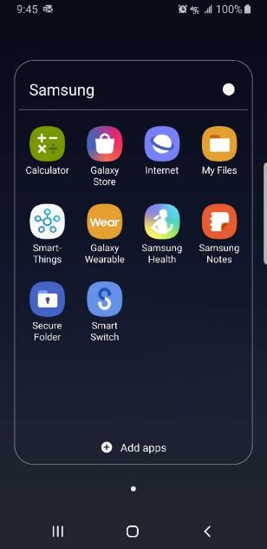
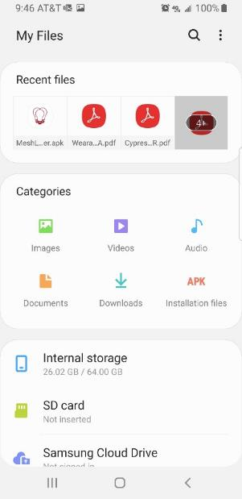
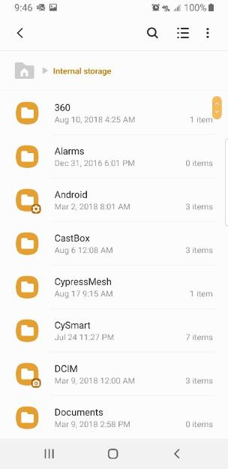
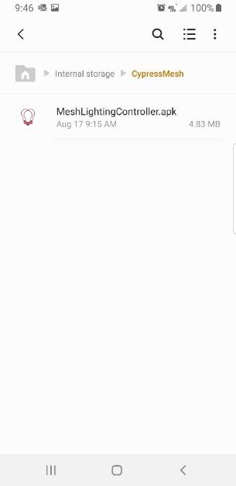
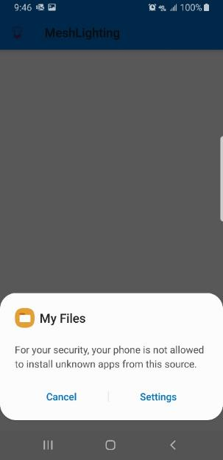
BLE Mesh App – Intro Android App Install (cont’d)
1 - Find the File System on your phone. It might be "My Files"
2 – Select Internal Storage.
(or look in Recent Files)
3 - Select the directory
4 - Select the application
5 - Select "Settings" to allow installation

Slide 7
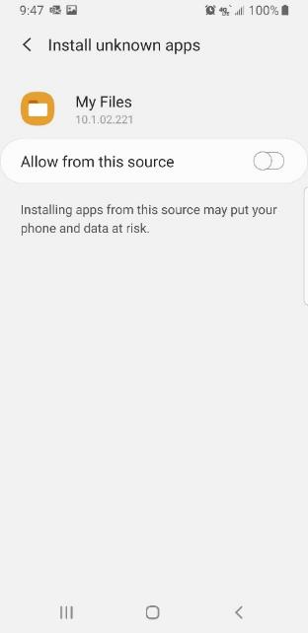
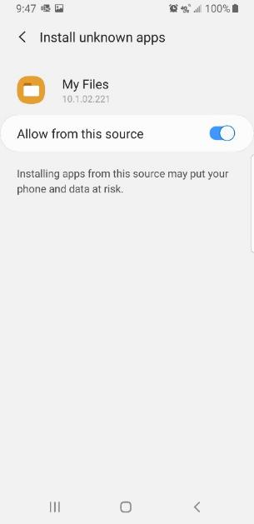
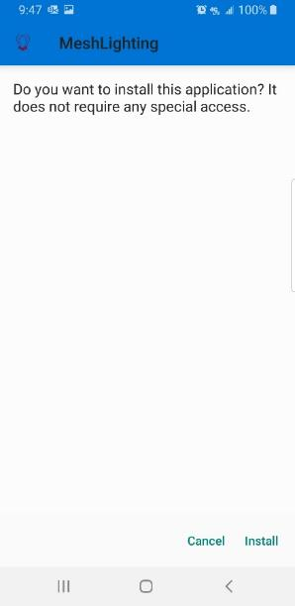
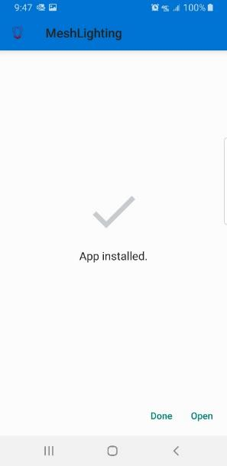
BLE Mesh App – Intro Android App Install (cont’d)
9 - There should be some positive indication when installation is complete
7 - There should be some positive indication showing allowance
8 - Install the application
6 - Select the toggle to allow installation

Slide 8
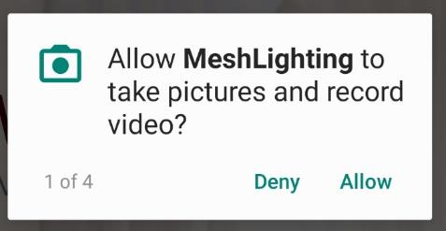
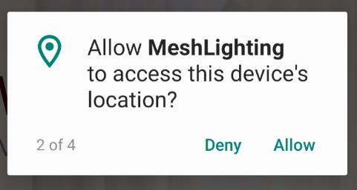
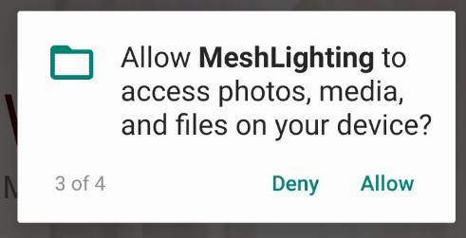
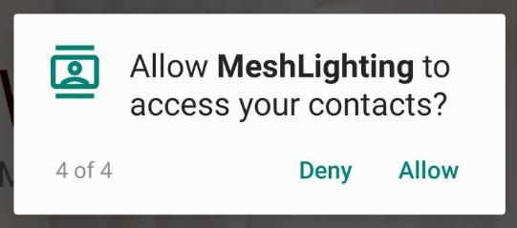
BLE Mesh App – Intro Android App Install (cont’d)
Allow the full access to enable all features.

